Slide 1
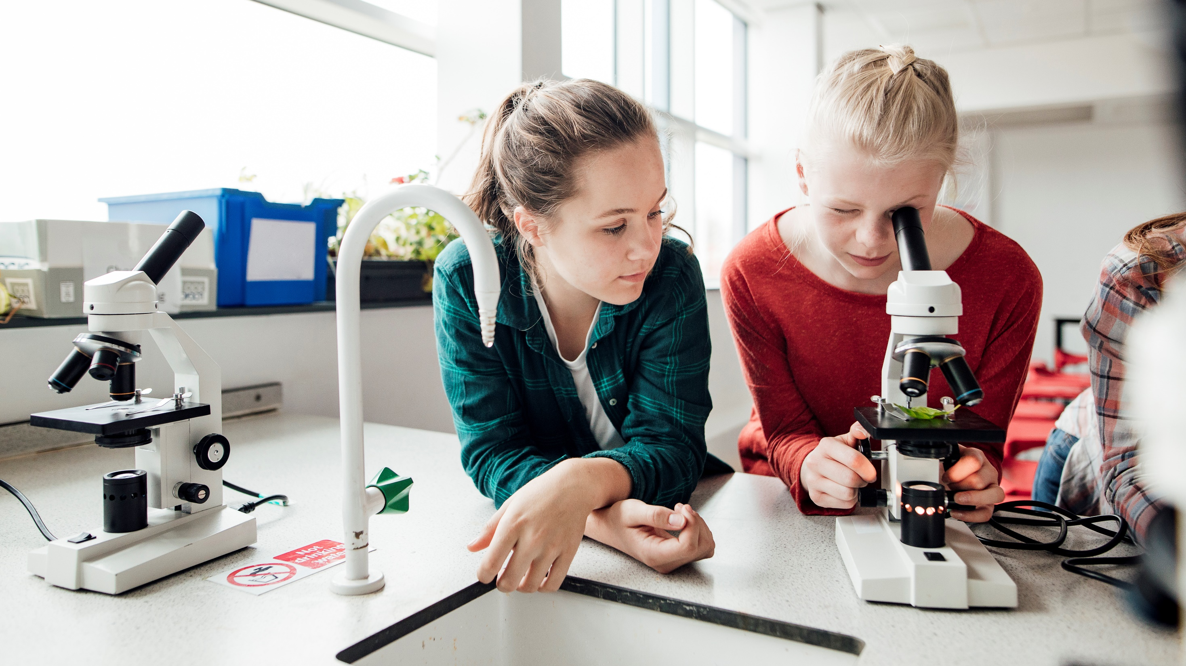
Mr. Jesse's Class Day 1 - Week 1

Slide 2
Our schedule
Dad joke of the day
Reading – Listen & Think ( 20 minutes)
Writing prompt (20 minutes)
Numeracy challenge (20 minutes)
Daily Physical Activity (DPA) Challenge (Additional)

Slide 3
Did you know the first french fries weren't cooked in france?
They were cooked in Greece...

Slide 4
The Hobbit – Pre-read activity
We were just revved up and ready to start "The Hobbit" by J.R.R Tolkien before the virus kicked us so rudely out of our school. I would love to continue this reading activity still.
If you are able, please head to chapter/walmart/amazon/your nearest nerd friend and grab yourself a copy of "The Hobbit". If that isn't a possibility, GREAT! We have an electronic copy available on Mr. Jesse's website.

Slide 5
What genre do you believe "The Hobbit" fits into? Why do you think that?
Watch the clip & have your child explain what genre this book may fit into. Here are some examples of genre
https://www.youtube.com/watch?v=SDnYMbYB-nU&feature=emb_logo
Adventure, Drama, Action, Fantasy, Fairy Tale, Mystery, Science Fiction...etc...

Slide 6
Writing Prompt of the day
If you could be in charge of any business in the world, what business would you take over? What changes would you make to make it better?
I'd love to hear your responses. Please share them with me on Microsoft Teams in the "Writing" Team for your grade. You can type this activity or hand write it and take a picture!

Slide 7
Numeracy Challenge
Today's numeracy challenge is all about division as that is where we left off before we left school.
Is it possible to divide these pizza's evenly between your family members? How many slices would each person get? What strategy did you use?

Slide 8
Numeracy Challenge
Today, ensure you jump onto Math Prodigy or Xtramath for at least 15 minutes.
www.xtramath.org
www.mathprodigy.com

Slide 9
Just Dance
We used to love Just Dance at school. Try this video out and see who can do it better, you or your family members!
https://www.youtube.com/watch?v=YLRnUx-1kyQ

Slide 10
Mr. Jesse's Class Day 2 - Week 1

Slide 11
Our schedule
Dad joke of the day
Reading – Listen & Think (20 minutes)
Writing prompt (20 minutes)
Numeracy challenge (20 minutes)
Daily Physical Activity (DPA) Challenge

Slide 12
Whenever I drive past a graveyard...
Did you know that's a popular graveyard? People are dying to get into it!

Slide 13
Reading activity
Please see www.jesse45s.weebly.com for "The Hobbit" reading schedule for this week.
Who is your favorite character in chapter 1? What character traits stand out to you as awesome?

Slide 14
Writing Prompt
If you could have any super power, what power would you choose? Why?
Design yourself as a super hero! I want to see that super suit, cape, logo, all of it!

Slide 15
Numeracy Challenge
Today's Numeracy challenge (March 31) is an event on math Prodigy!
Meet us at 11:00am at the Titan on the Keystone Server. Mr. Jesse will be here too! Let's rock out some Titan together as a group!
If you cannot attend, please see the Math Worksheet available on our website for Week 1 Day 2

Slide 16
Daily Physical Activity Challenge
Time to get SWOLE! Pull a Terry Crews and rock out some push ups today!
I challenge you to post your push up video on FlipGrid and share your push up totals! See who can do the most!

Slide 17
Mr. Jesse's Class Day 3 - Week 1

Slide 18
Our schedule
Dad joke of the day
Reading – Listen & Think (20 minutes)
Writing prompt (20 minutes)
Numeracy challenge (20 minutes)
Daily Physical Activity (DPA) Challenge

Slide 19
A slice of apple pie is $2.50 in Jamaica, and $3.00 in the Bahamas...
Those are the Pie rates of the Caribbean

Slide 20
Reading activity
Please see www.jesse45s.weebly.com for "The Hobbit" reading schedule for this week.
Talk to your parents after listening/reading this chapter. Tell them what happened. Tell them about the characters. Retell as much as you are able! Retelling stories is an important strategy to improve reading/writing skills.

Slide 21
Writing Prompt
If you were a super villain, who would your villain be?
Design your villain just like you did with yourself as a super hero, and remember...
NO CAPES!

Slide 22
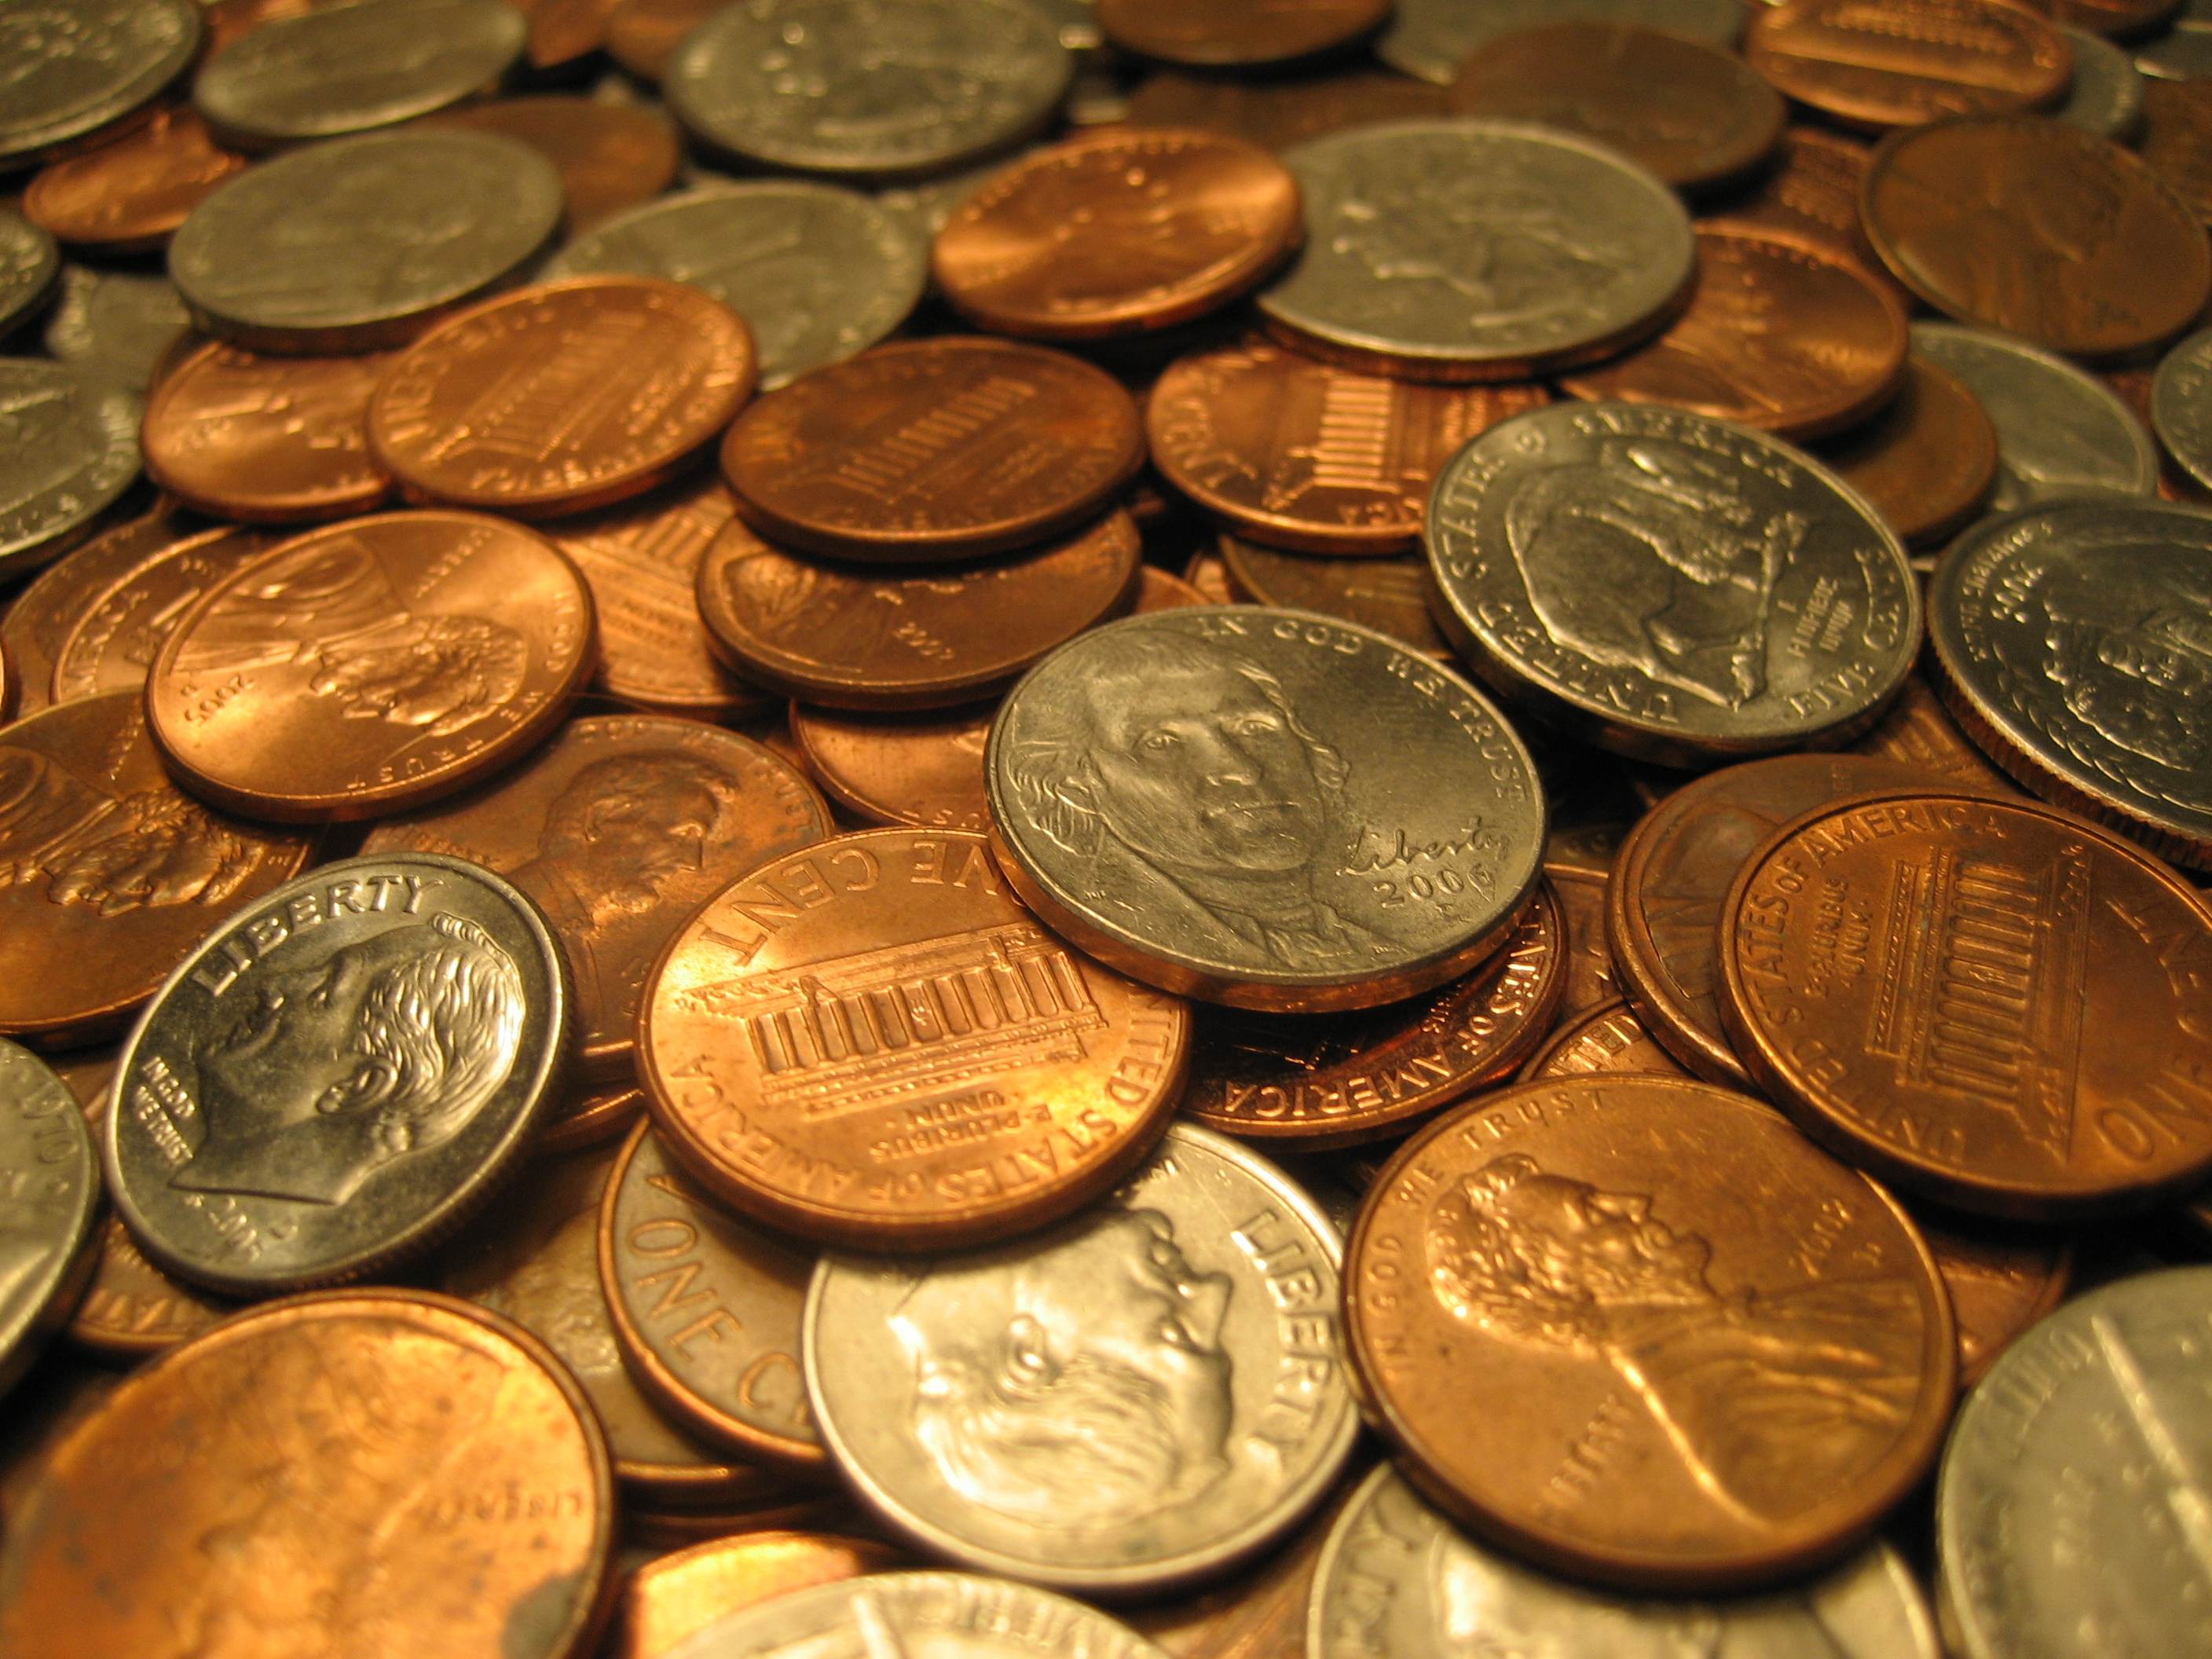
Numeracy Challenge
Today's activity will keep you busy with numeracy skills.
Find as much change (pennies, nickles, dimes, quarters, etc...) around the house as possible.
Do your parents a solid, count the change! How much did you find?
How do the coins look different? How much is each one worth?

Slide 23
Daily Physical Activity Challenge
Time to get moving! Let's go for a community walk. Make sure to stay a few steps away from everyone else you're walking with, but get some fresh air!
Take 5-10 pictures on your walk, or record any cool things you see.
If you are living anywhere near Legacy Ridge, there are some very cool window displays going up to go and see. People are trying to help kids WANT to go outside and see funny stuff. Check it out!

Slide 24
Mr. Jesse's Class Day 4 - Week 1

Slide 25
Our schedule
Dad joke of the day
Reading – Listen & Think (20 minutes)
Writing prompt (20 minutes)
Fine Arts Activity20 minutes)
Daily Physical Activity (DPA) Challenge

Slide 26
Unwritten rules of life...
1)
2)
3)

Slide 27
Reading activity
Please see www.jesse45s.weebly.com for "The Hobbit" reading schedule for this week.
Using video/drawings, recreate a scene from the book in your own vision. What is the setting? What characters are involved?
If you choose to do a video, share it with us on Flip Grid!

Slide 28
Writing Prompt
Yesterday, you created a villain. Today, I'd like to you create a 10 panel comic strip of yourself fighting crime or saving the world!
You should include a Beginning, Middle, and End. In this story there should be one central problem that should be solved.
Use full color, and ensure that your comic is as appropriate as possible so that we can share them around! (No blood, death, gore, etc...)
There will be a comic strip template you can print out on our class website.

Slide 29
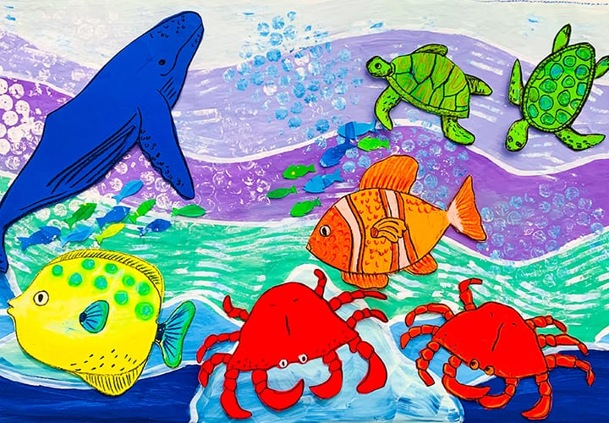
Fine Arts ACtivity
Please see the attached link for an awesome wall/window design that you can do at home as your Fine Arts activity for the week.
https://www.deepspacesparkle.com/marine-life-collaborative-mural/

Slide 30
Mr. Jesse's Class Day 5 - Week 1

Slide 31
Our schedule
Dad joke of the day
Reading – Listen & Think (20 minutes)
Writing prompt (20 minutes)
Math Challenge (20 minutes)
Daily Physical Activity (DPA) Challenge

Slide 32
Reading activity
Please see www.jesse45s.weebly.com for "The Hobbit" reading schedule for this week.
Using video/drawings, recreate a scene from the book in your own vision. What is the setting? What characters are involved?
If you choose to do a video, share it with us on Flip Grid!

Slide 33
Writing Prompt
Today is the day of sharing. Find anyone in your world who you can share with safely and read them your comic. Have them ask you some questions about it.
This is your chance to begin building up your own imaginative world. When difficulty in life arises, written imagination can help us get through in a positive way!

Slide 34
Numeracy Challenge
Today is another money day!
I'd like you to go online shopping with your family. Some great websites are Walmart.ca, amazon.ca, or ebay.ca.
Put together a shopping cart of essential items and add it all together. How much does that cost? How much did you have in spare change on Wednesday?
Parents, the focus of the lesson is how expensive life can be and build an appreciation of value.

