Slide 1
Week Two Day 1
Jesse’s Grade 4/5 – 2019/2020

Slide 2
Daily Schedule
Daily joke
Reading Activity
Writing Activity
Numeracy Activity
Daily Physical Activity (DPA)

Slide 3
Daily Joke
What kind of food does a vegetarian zombie eat?
GRAAAAAAAINS

Slide 4
Reading Activity
Please see the online schedule for reading on www.jesse45s.weebly.com under the “Class Work” tab.
Please read the chapter assigned for today and respond to the question below by talking to your parents.
“What happened during this chapter? What were you left wondering after this chapter?”

Slide 5
Writing Activity Day 1
This week’s theme is… Fairy tales
For today’s writing activity, you are going to do some reading OR watching of films.
Step 1: Watch the following video: https://www.youtube.com/watch?v=isWwIwtAn8M
Select one of the titles to read online, or watch online!
Our primary goal for today is introduce you to the Fairy tale genre.

Slide 6
Numeracy – Day 1
This week’s focus is measurement. You will need the following materials for this week;
A ruler (not accessible online ☺ )
A digital clock (accessible online)
An analog clock (accessible online)

Slide 7
Numeracy Day 1 Continued
Today’s lesson is on the different measurements we can look at using our tool; a ruler.
https://www.youtube.com/watch?v=cKbmvLv-FRo
Please start with the above video.
Once you are done, have some fun measuring! Measure and record the length of at least 10 different objects in or around your home. Have your parents help you if you need to measure large items like a fridge or a door!

Slide 8
Week Two Day 2
Jesse’s Grade 4/5 – 2019/2020

Slide 9
Daily Schedule
Daily joke
Reading Activity
Writing Activity
Numeracy Activity
Daily Physical Activity (DPA)

Slide 10
Daily Joke
Kid: “Dad, make me a sandwich please!”
Dad: “Poof! You’re a sandwich!”

Slide 11
Reading Activity
Please see the online schedule for reading on www.jesse45s.weebly.com under the “Class Work” tab.
Please read the chapter assigned for today and respond to the question below by talking to your parents.
“Bilbo is a loveable character. What are your favorite moments that Bilbo has had so far?”

Slide 12
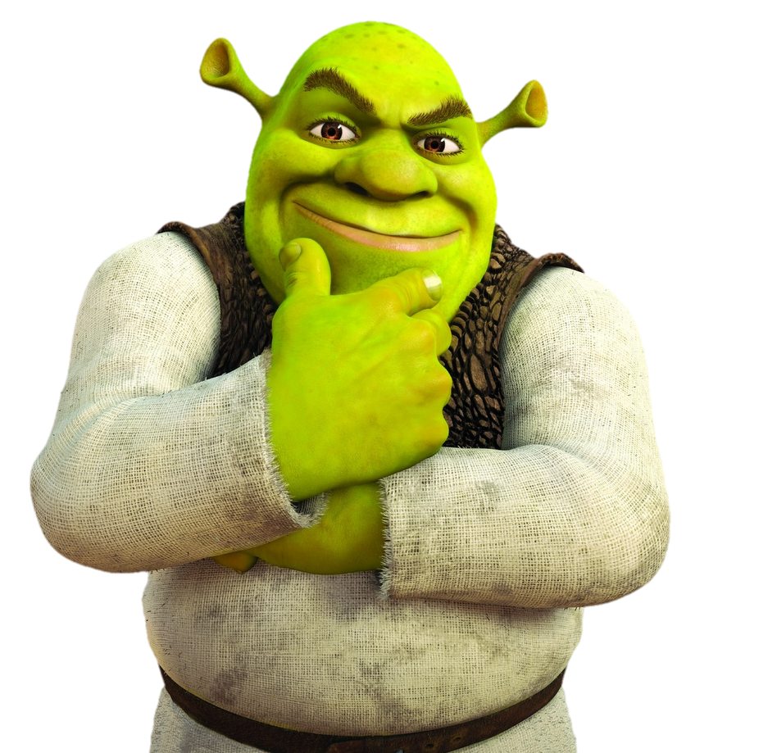
Writing Activity Day 2
Yesterday you read a fairy tale or watched a fairy tale. Today, we are going to be considering how regular fairy tales turned into…
Fractured Fairy Tales
A Fractured Fairy tale is a once whole fairy tale that has been warped and changed through a new writer.
Are you ready to take on the challenge of creating your own fractured fairy tale?

Slide 13
Writing Activity Day 2 Continued…
Select one of your all-time favorite fairy tales. This could be one of the films you watched yesterday or a story that you have read.
Decide on a change to improve the story.
Make the change lead to other changes so the whole story fits together.
Today, begin by simply writing the story. Enjoy it! Have fun with it! Include colorful pictures to explain your writing!

Slide 14
Numeracy Day 2
Well, distance is one thing we measure… Another area we focus on measuring is time during our minutes, hours, days, weeks, months…
Today you will be creating your own handheld analog clock.
Print out the following page, or create something similar using the tools available at home.
Parents, go through a regular schedule of a day and walk using the big hand (minutes) and small hand (hours), and how to show those.

Slide 16
Week Two Day 3
Jesse’s Grade 4/5 – 2019/2020

Slide 17
Daily Schedule
Daily joke
Reading Activity
Writing Activity
Numeracy Activity
Daily Physical Activity (DPA)

Slide 18
Daily Joke
Why did the invisible man reject his latest job offer?
He couldn’t see himself doing it.

Slide 19
Reading Activity
Please see the online schedule for reading on www.jesse45s.weebly.com under the “Class Work” tab.
Please read the chapter assigned for today and respond to the question below by talking to your parents.
“How does Gollum figure out that Bilbo had the ring?”

Slide 20
Writing Activity Day 3
Yesterday you began writing your first fractured fairy tale for fun.
Today, I’d like you to continue to make some changes to your story and continue to write. Good writers take their time to finish telling their story, I’d like you to do the same.
If you have already finished your story on the first day because you worked extra hard, Please jump to Writing Activity Day 4.

Slide 21
Numeracy Day 3
Today’s focus is using a measurement of time to realize the length of time in a day.
Create a daily schedule for the next 2-3 days. Create blocks of time that will include 15 minutes, 30 minutes, 60 minutes, or even 120 minutes.
Set an alarm on a phone/device to remind yourself of when you are starting these blocks of time.
Parents, the focus is that students learn lengths of time. It may feel different based on how busy you are keeping, but we hope that they experience this.

Slide 22
Exemplar for Numeracy Day 3
8:00 – Wake up
8:00-8:15 – Clean my room (15 minutes)
8:15-8:45 – Have breakfast & watch cartoons (30 minutes)
8:45-9:45 – Help clean the house (60 minutes)
9:45-11:45 – Go for a walk with my parent/guardian (120 minutes)

Slide 23
Week Two Day 4
Jesse’s Grade 4/5 – 2019/2020

Slide 24
Daily Schedule
Daily joke
Reading Activity
Writing Activity
Numeracy Activity
Additional:
Fine Arts Activity (Drama, Dance, Art, Music)
Daily Physical Activity (DPA)

Slide 25
Daily Joke
Cashier: “Would you like your milk in a bag?”
Dad: “No, I’d like it in the carton please!”

Slide 26
Reading Activity
Please see the online schedule for reading on www.jesse45s.weebly.com under the “Class Work” tab.
Please read the chapter assigned for today and respond to the question below by talking to your parents.
“How does Bilbo trick Gollum?”

Slide 27
Writing Activity Day 4
Today we are going to focus in on some of the smaller details of our story. Today’s focus is in character.
Print off the sheet that will follow this slide. Complete a character sketch for your main character! Really give it some thought and creativity.
We want this character to sparkle with Fairy tale magic!

Slide 29
Numeracy Day 4
Problem solving with time
Using the analog clock you created on Day 2 this week, please head to the following site to create yourself some awesome worksheets for time problem solving.
Alternatively, please sign into Math Prodigy as a similar assignment has been set up for this day.
https://www.math-aids.com/Time/Time_Worksheets_Adding.html

Slide 30
Fine Arts Activity – Week 2
Today is a drama game for you to play with your family/friends!
Please ensure to keep social distancing (2m away) while playing.
http://www.bbbpress.com/2017/01/drama-game-ninja-star-baby-kitten-angry-chihuahua/

Slide 31
Week Two Day 5
Jesse’s Grade 4/5 – 2019/2020

Slide 32
Daily Schedule
Daily joke
Reading Activity
Writing Activity
Numeracy Activity
Daily Physical Activity (DPA)

Slide 33
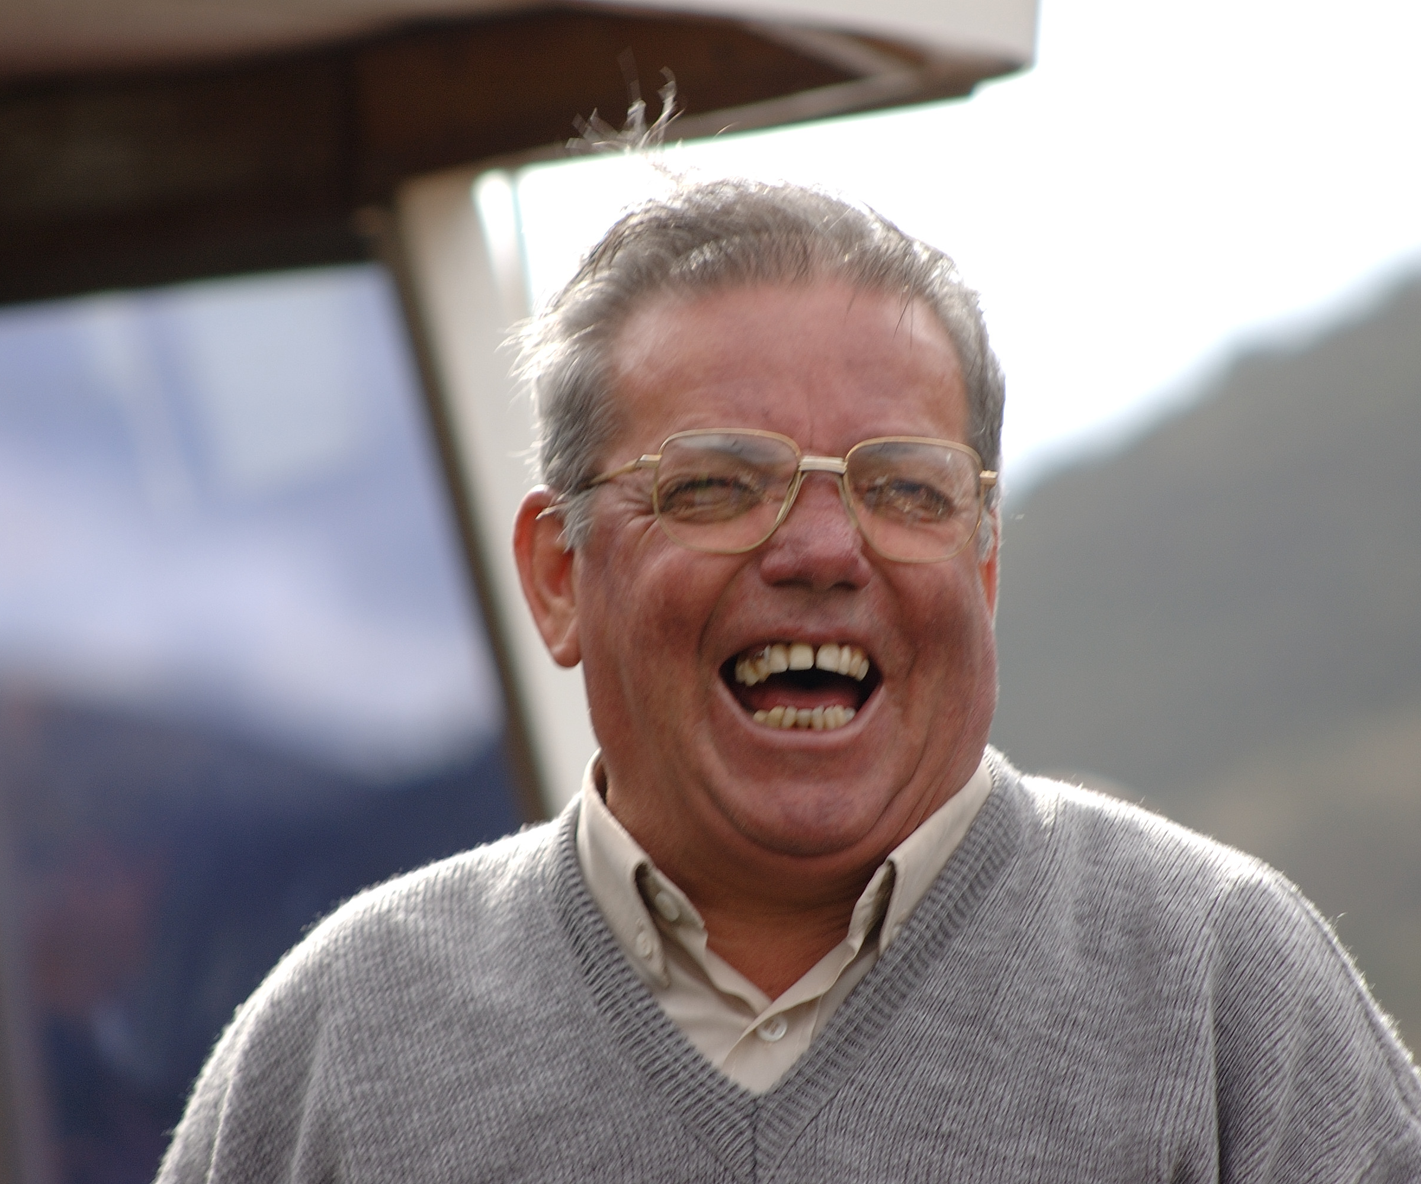
Daily Joke
5/4 people admit that they are bad at fractions.

Slide 34
Reading Activity
Please see the online schedule for reading on www.jesse45s.weebly.com under the “Class Work” tab.
Please read the chapter assigned for today and respond to the question below by talking to your parents.
“How did the dwarves react to Bilbo’s return? How did Gandalf react?”

Slide 35
Writing Activity Day 5
Today, we will be breaking down our story into small pieces.
Using the handouts on the next slides, break your story down into a Beginning, Middle, Climax, and End.
You can print these or screenshot them and plop them into Microsoft Paint to edit.
There are some different options for handouts for this. Pick the one that you think works best for you. Every learner is different.

Slide 37
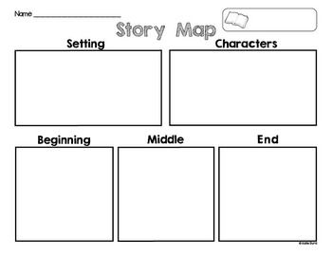

Slide 38
Climax
Middle
End
Beginning

Slide 39
Numeracy Day 5
Elapsed Time
Please see the following link for assignments for Elapsed time. This should be straight forward for students. They may use their analog clock from Day 2 to support.
Alternatively, here is a fun little pac-man game that runs through the same skills online.
https://www.sheppardsoftware.com/mathgames/time/mathman_time_elapsed.htm

